Slide 1
Cost-Map Generation and Heuristic Based Optimal Path Planning for Neurosurgical Tools
ENPM 661 Prof. Reza Monfaredi
Team:
Patan Sanaulla Khan (116950985)
Srikumar Muralidharan (116950572)
Sahana Anbazhagan (116702720)

Slide 2

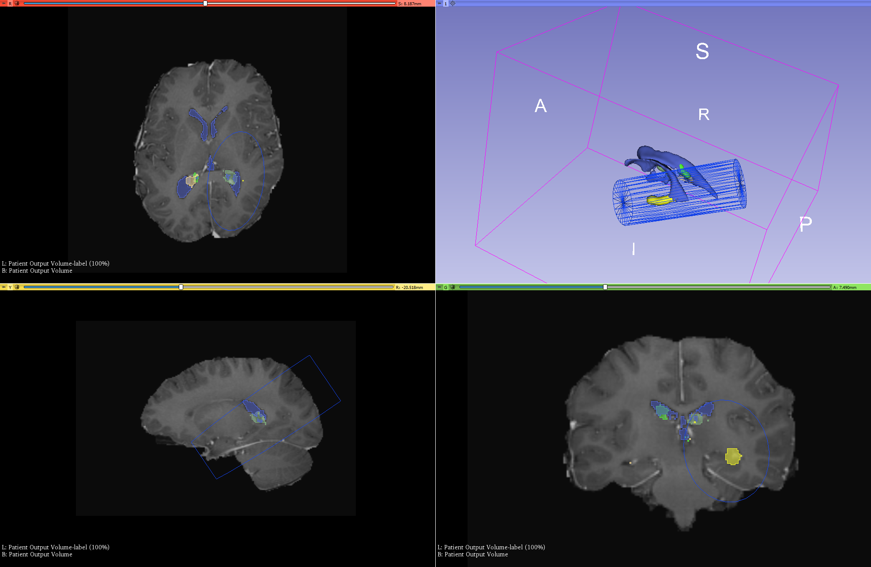
Introduction
Existing surgical procedures depend on surgeon in performing path planning based on the CT or MRI and carry out the surgery.
Manual planning for tumor ablation is very time consuming.
Generate cost map and an optimal path based on the cost-map where cost is determined based on the risk for each segmented component in the brain.
Don’t touch or go near vital regions (vessels and ventricles)
Insertion depth < needle length
Target is hippocampus head and body not tail
Reference : Research on Heuristic Based Optimal Path Planning for Neurosurgical Tumor Ablation, Reza M, et al

Slide 3
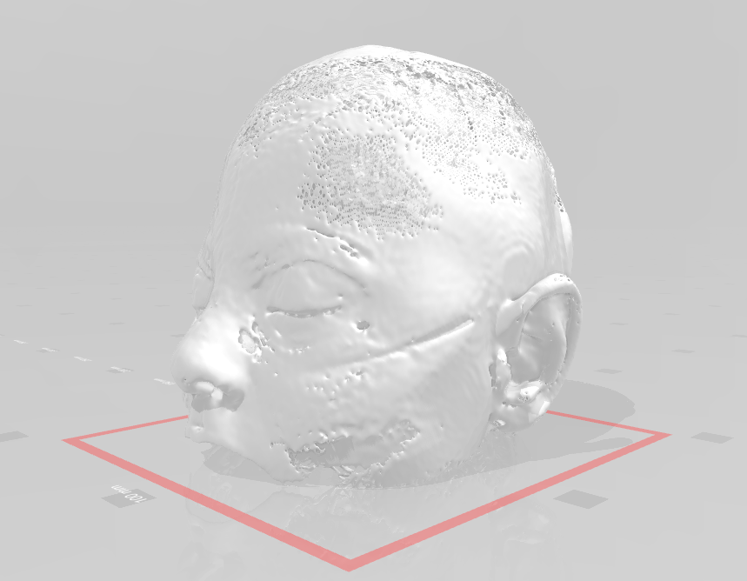
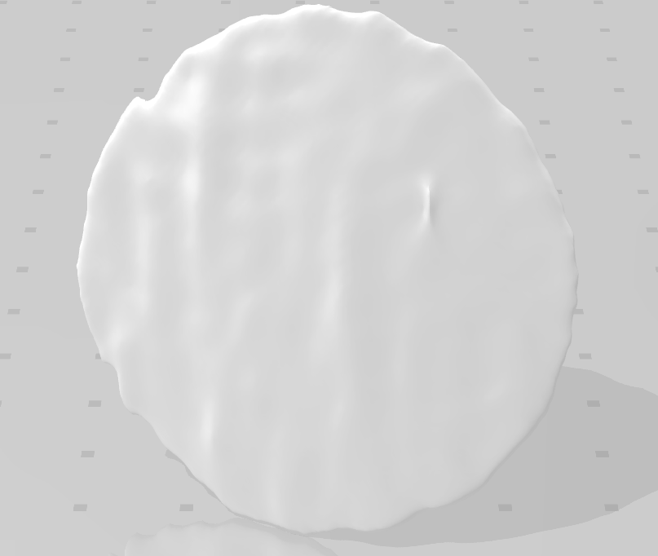
Data Preparation
STL model of the brain acquired from a patient
Converted this to a readable format in MATLAB and python
We convert STL data into triangulation points - determine the various regions of the brain
NRRD files need to be converted to point cloud data
STL skull data are imported as TR/triangulation objects
MRI data is imported as point cloud
Notes:
We have a stl model of the brain acquired from a patient. We have to convert this to a readable format in MATLAB and python.
So we convert stl data into triangulation points which is used to determine the various regions of the brain. We only perform that on the skull data.
NRRD files need to be converted to point cloud data which has been saved as a .mat file.
Then the stl skull data are imported as TR/triangulation objects and the MRI data is imported as point cloud.

Slide 4
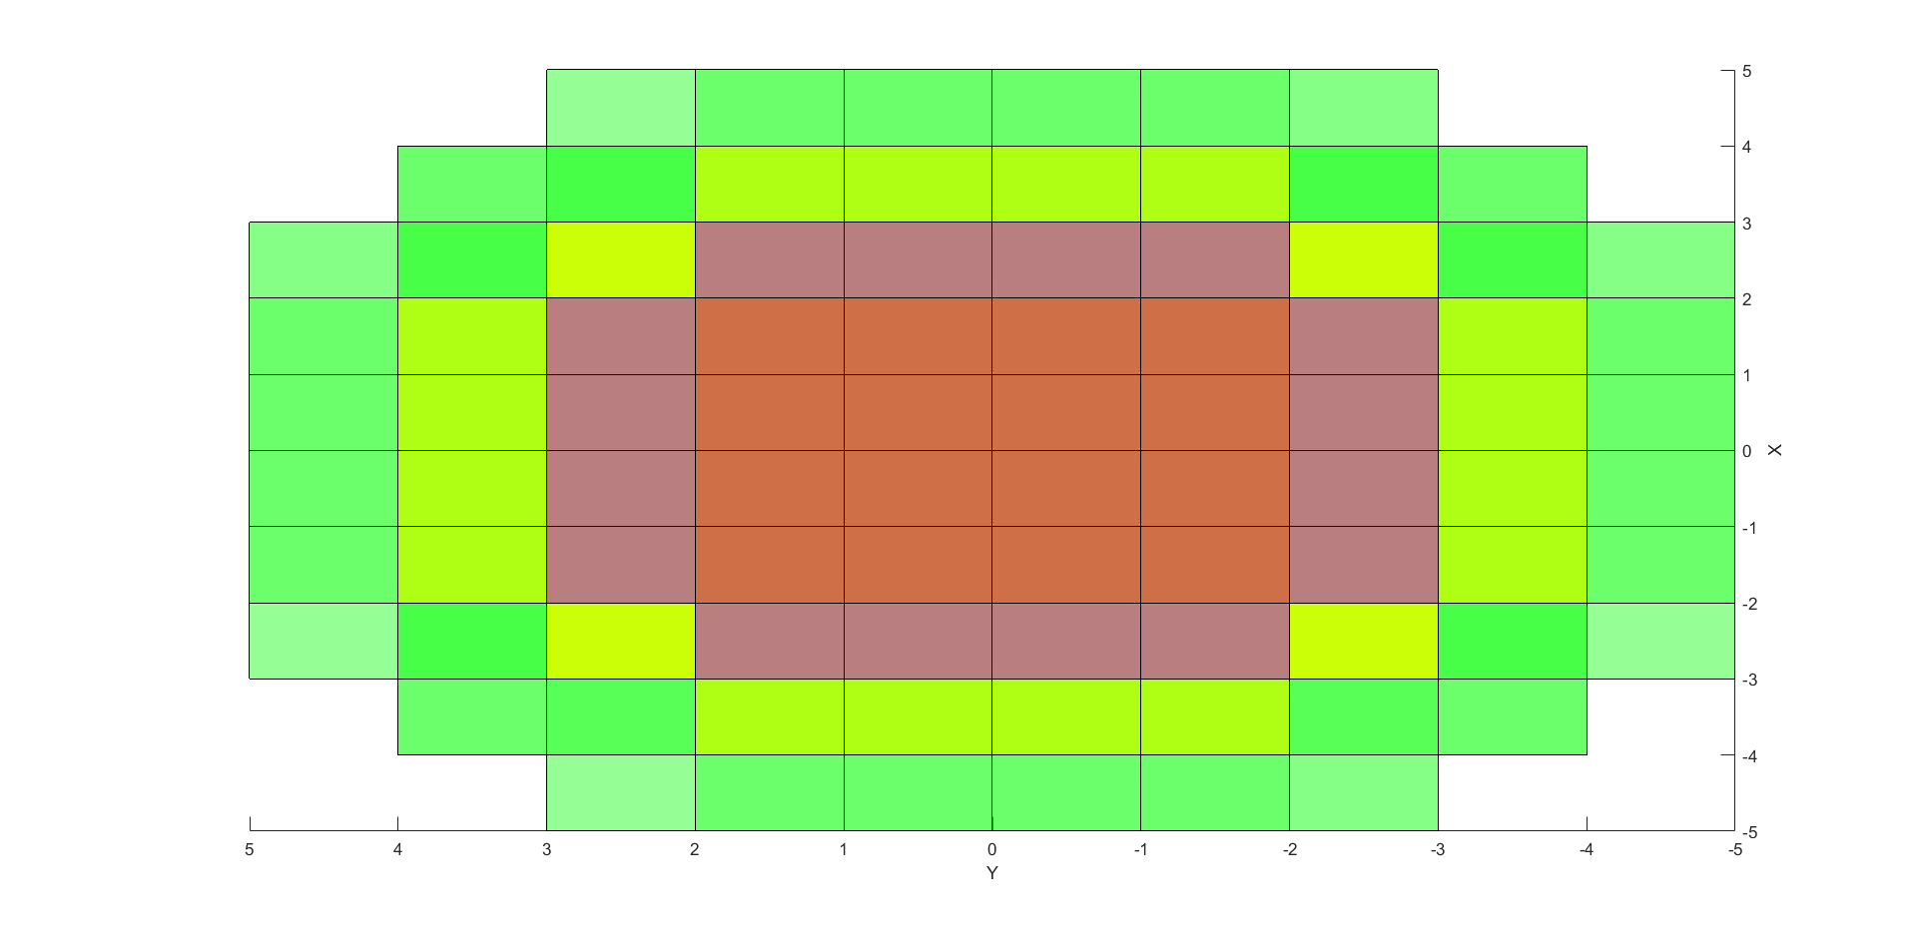
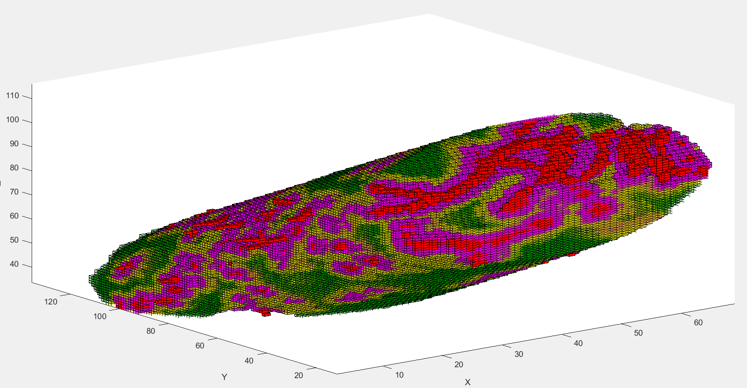
Phase 1 and 2 - Cost Map Generation and A * Algorithm
Risk estimation based on the proximity with the critical points
red - critical region to be avoided
purple - close to the critical region, safe but still to be avoided
yellow - safe distance, relatively safe
green - possible area for needle insertion
Reference : Research on Heuristic Based Optimal Path Planning for Neurosurgical Tumor Ablation, Reza M, et al
Notes:
Provided point cloud data to be formatted to achieve a cost map.
Color coding and segmentation is done for our input (cloud point data). We select a start point and implement our search algorithm and set goal to be the first obstacle we reach.
Once an obstacle is reached, we calculate cost associated with reaching said obstacle and assign colors based on predetermined threshold values.

Slide 5
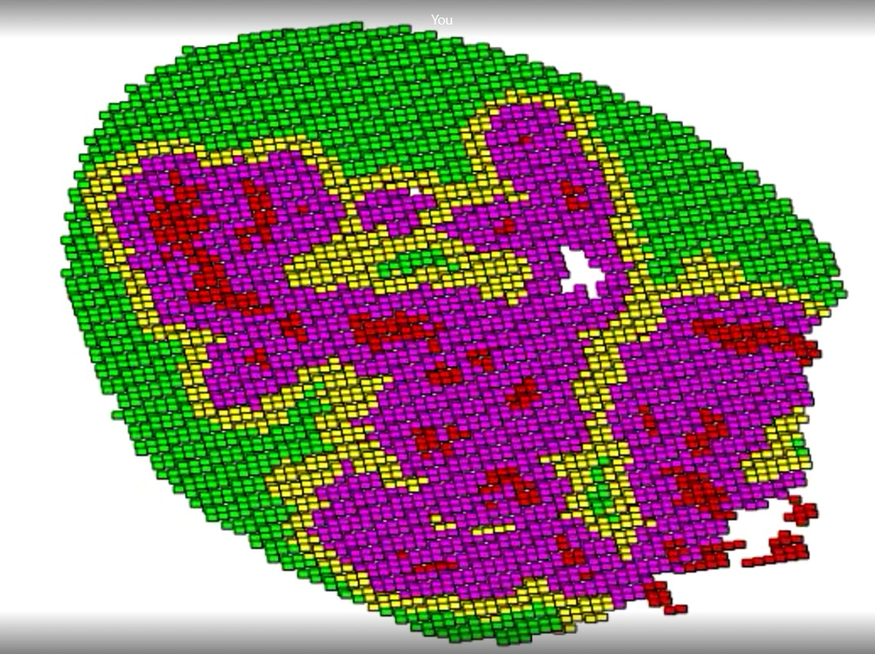
Phase 1 – Generation of cost map

Slide 6
Updated Cost Map
Reduced the number of iterations
Improved segmentation of vessels, ventricles, hippo campus and the rest of the brain ROI
Observed result – 43% (approx) reduction of time for cost map generation
Parameters | Previous version | Updated version
Execution time | 231s | 132s
Voxel map array length | 285018 | 272967
Total number of iterations | 285018 | 256002
Considering structures to be mutually exclusive | No | Yes

Slide 7
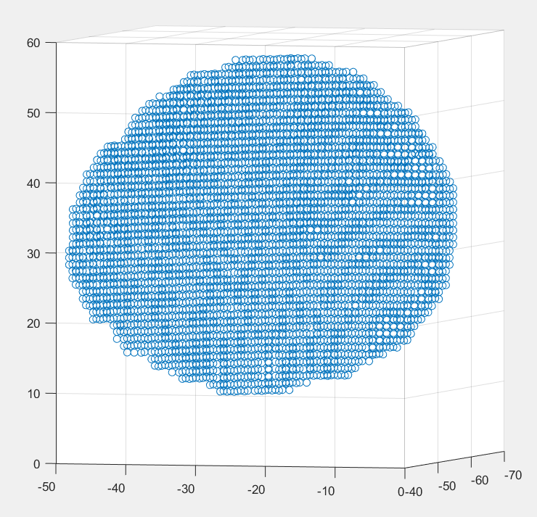
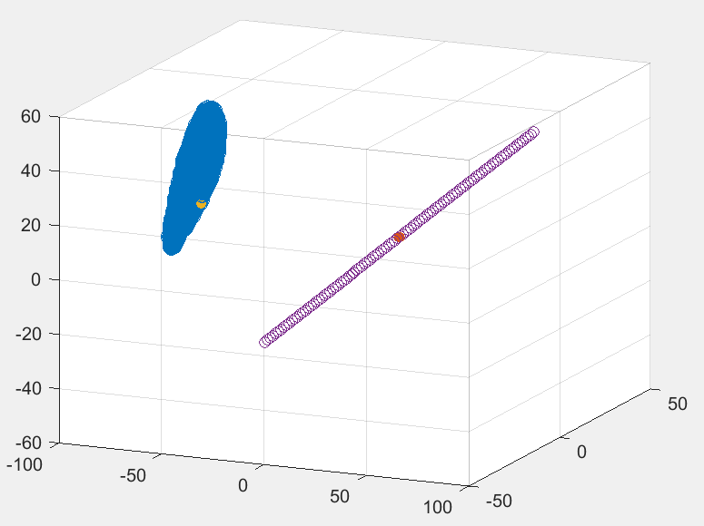
Start point(yellow), Tumor axis line (purple), End point(red)
Left Skull STL as Point Cloud data

Slide 8
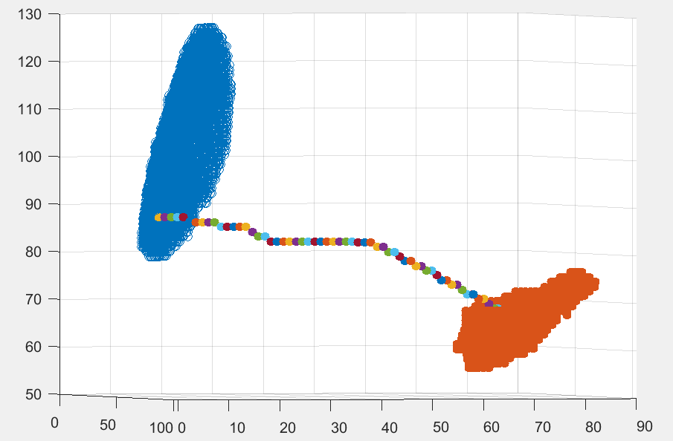

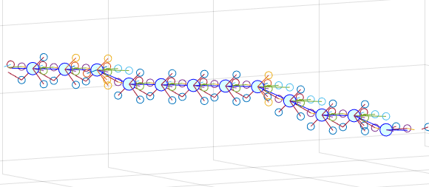
Phase 2 – Path planning – A* algorithm

Slide 9
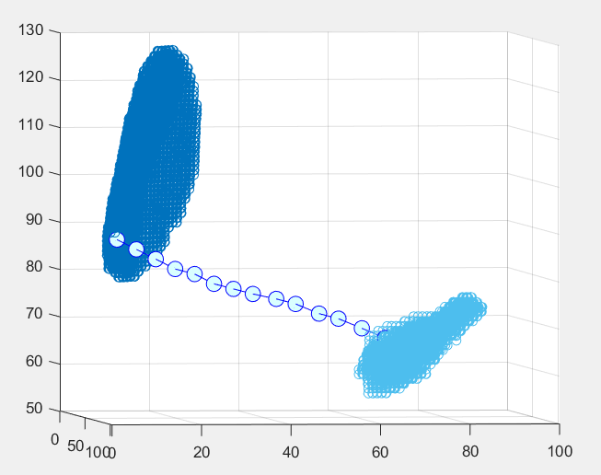
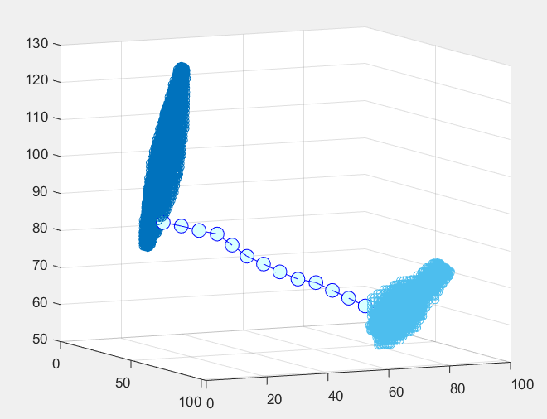
Results - Varying the angular resolution and step size
Angular resolution = 10, Max Angle = 30
and step size = 5
Angular resolution = 1, Max Angle = 5
and step size = 5

Slide 10
Future Scope
Expanding action set from straight lines of small step size to curved path for surgical needles
Increasing the number of possible entry points to minimize human errors

Slide 11
Thank you for you time and attention! Questions ?

